Slide 1
Web Development
CSE343
Lab 10

Slide 2
Intro

Slide 3
What We’ve Done So Far
Until this point, we've built a complete full-stack web application:
We built our frontend – the user interface displayed to the user, created with React, handling user interactions and presenting data in a clean, responsive way.
We built our backend – the server-side logic using Node.js and Express.js, which processes requests, handles business logic, and communicates between the frontend and database.
We added a database – MongoDB – to persist and manage our application's data, allowing us to store, retrieve, update, and delete information.
Now, the next step is to take our application from our local development environment and make it accessible to the world!

Slide 4
Local Development
Right now, your application runs on your computer (localhost). When you start your:
Frontend (React) – it runs on http://localhost:3000
Backend (Express server) – it runs on http://localhost:5000 (or another port)
Database (MongoDB) – it runs locally on your machine
The problem? Only YOU can access it. No one else on the internet can see or use your application because it's not publicly accessible – it only exists on your machine.
To make your application available to anyone, anywhere, you need to deploy it.

Slide 5
Deploying your code
Deployment means:
Moving your code to a server that's always online
Unlike your laptop, which you turn off, cloud servers run 24/7
These servers have public IP addresses that anyone can reach
Giving your app a real URL
Instead of localhost:3000, users access something like https://myawesomeapp.com
This requires hosting and potentially a domain name
Ensuring all parts work together in the cloud
Your frontend needs to be hosted (e.g., on AWS S3, Firebase Hosting)
Your backend needs to run on a server (e.g., AWS EC2, Heroku)
Your database needs to be accessible (e.g., MongoDB Atlas, AWS RDS)

Slide 6
AWS

Slide 7

What is AWS?
Amazon Web Services (AWS) is a cloud computing platform provided by Amazon. It offers over 200 services that help developers build, deploy, and manage applications without needing to own or maintain physical servers.
Think of AWS as renting computing power, storage, and services from Amazon's massive data centers around the world, instead of buying and managing your own servers.

Slide 8
What is Cloud Computing?
Before we dive into AWS, let's understand cloud computing:
Traditional Way (Before Cloud):
Companies bought physical servers
Hired IT staff to maintain them
Paid for electricity, cooling, security
If traffic increased, they had to buy MORE servers (expensive and slow)
Cloud Computing Way
Rent servers and services from providers like AWS
Pay only for what you use (like electricity)
Scale up or down instantly based on demand
No hardware maintenance needed

Slide 9
Core AWS Services for Web Development
Let's focus on the services most relevant for deploying your web applications:
EC2 (Elastic Compute Cloud)
S3 (Simple Storage Service)
RDS (Relational Database Service)

Slide 10
EC2 (Elastic Compute Cloud)
Amazon EC2 (Elastic Compute Cloud) is AWS's service that provides virtual servers in the cloud.
Think of EC2 as renting a computer from Amazon that runs 24/7 in their data centers. You can install any software, run any application, and configure it however you want – just like your own physical computer, but in the cloud.

Slide 11
How to Deploy a simple node js website on AWS

Slide 12
Step 1: Head to AWS
Head to aws by navigating to this link https://aws.amazon.com/free/ and create a free aws account
You will need to enter your credit card information. Amazon gives you a free tier that you will not get charged on your credit card with as long as you did not exceed the free tier limit.

Slide 13
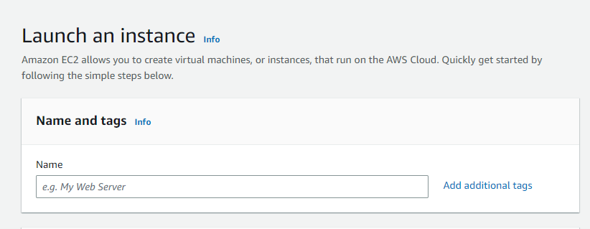
Step 1: Create an EC2 instance
EC2 as we said is an aws service that allows you to create virtual servers. Amazon calls them instances
You can launch, manage, and resize these instances and you don’t have to worry about managing physical servers. We will use it to host our app

Slide 14
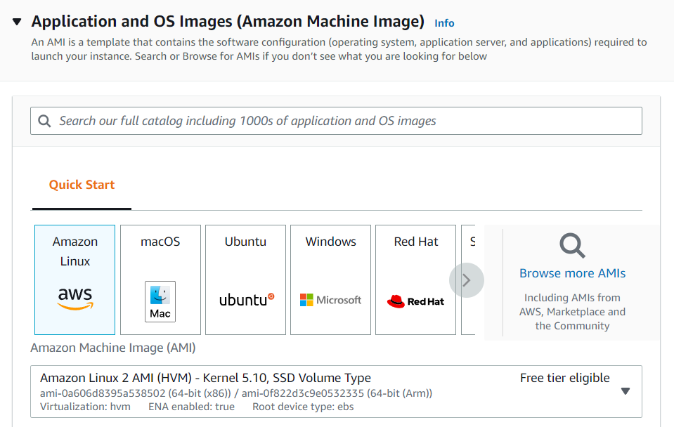
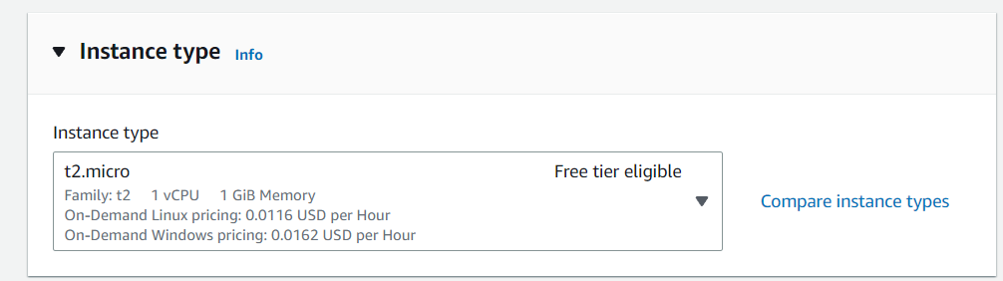
Step 1: Create an EC2 instance
Choose the OS that will run on your server
After that you will choose the instance type of the web server which is how much cpu and memory your server will have

Slide 15
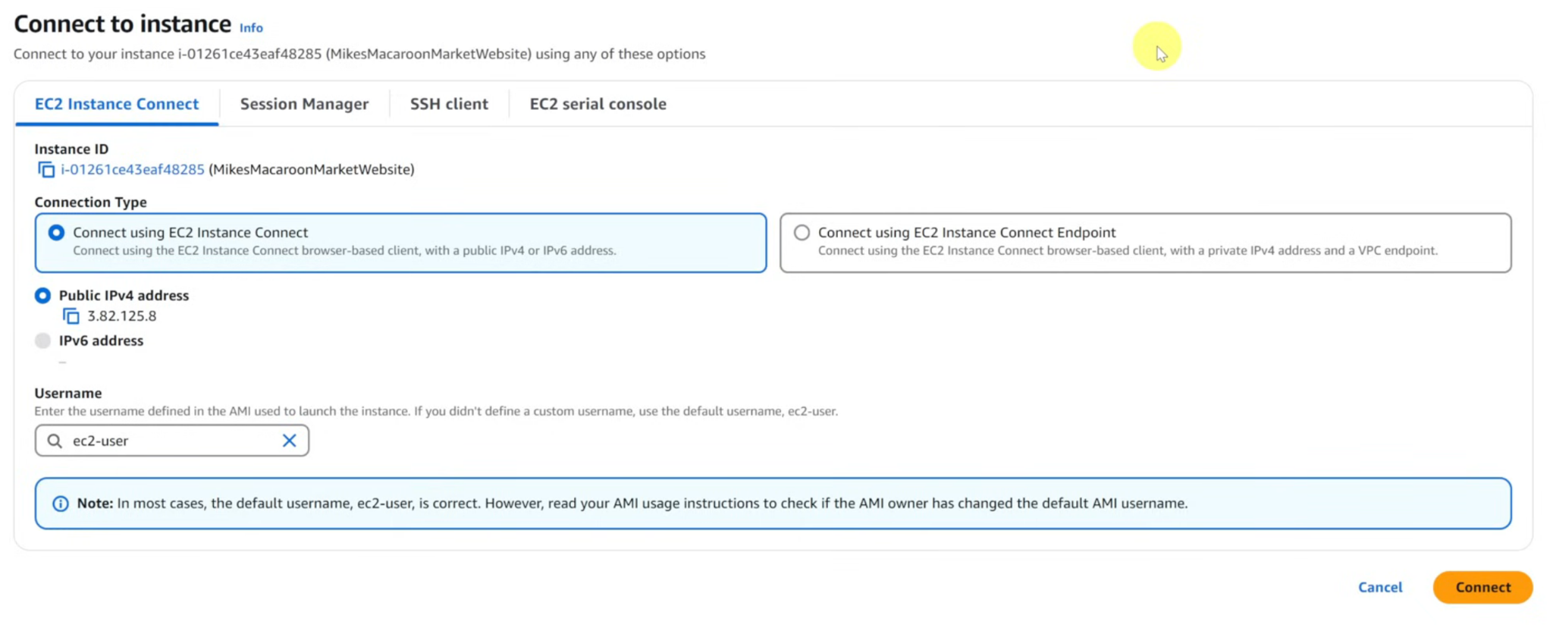
Step 2: Connect to your EC2 instance
After successfully creating your instance the next step is connecting to the instance to start navigating in it
There are a number of ways to connect to an instance. But the easy way is to use EC2 Instance Connect. This allows us to SSH into our instance.

Slide 16
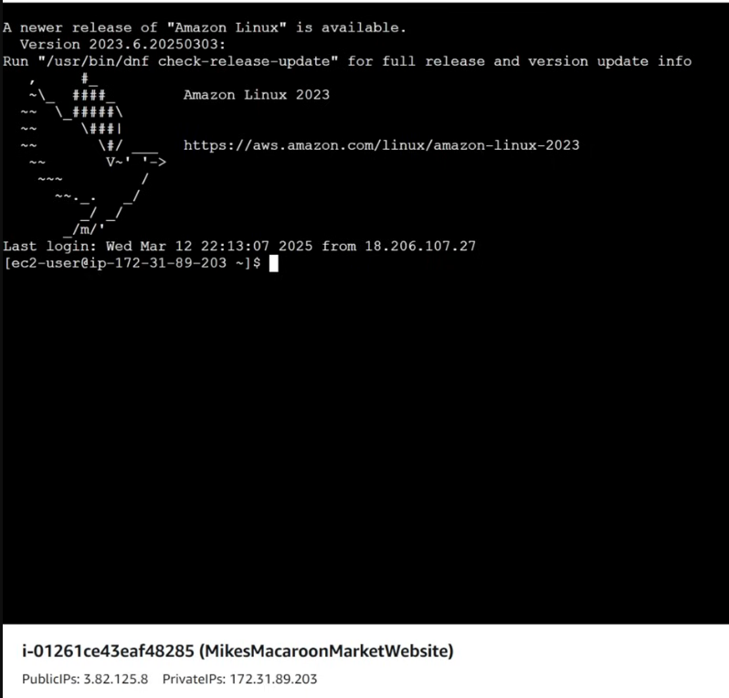
Step 3: Setting up our website in our instance
Now that we have connected to our instance, the next step is to set up our website. This involves running a series of commands. These commands include: installing git, git cloning the repo of your web server, installing nodejs, installing all dependency packages of your server, and finally starting your web app

Slide 17
Docker

Slide 18
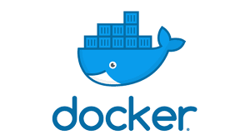
What is Docker?
Docker is a platform that allows you to package your application and all its dependencies into a container that can run consistently on any computer, server, or cloud platform.

Slide 19
The Problem Docker Solves
Docker solves the "It Works on My Machine" Problem
Imagine the following:
You build an app on your laptop: Node.js version 18, MongoDB version 6, Ubuntu Linux OS, with specific libraries and dependencies
Your teammate tries to run it: Node.js version 16 ❌, MongoDB version 5 ❌, Windows OS ❌, Missing dependencies ❌

Slide 20
How Docker solves the problem
With Docker, you package:
Your application code
Node.js runtime
MongoDB
All dependencies
Configuration files
Into one container that runs exactly the same on any computer

Slide 21
Key Concepts in Docker

Slide 22
Docker File
Docker Files:
A docker file is a text file with instructions to build a Docker image
Defines what goes into your container
This is the starting point for your application
It contains a series of commands that specify how to run your program. This includes things like:
Copying directories
Installing dependencies
Running your main process in your app
Think of it as a a step-by-step recipe for building your container environment

Slide 23
Docker Image
Docker Images:
After creating your docker file, this docker file is build into an executable package called a Docker Image
Docker Images include everything needed to run your app including code, runtime (ex. Nodejs, python), libraries, environment variables, and dependencies (npm packages and libraries).
Images usually inherit from a bas image that contains pre-installed dependencies that you can use right away.
A blueprint or template for creating containers
Contains your app code, runtime, libraries, and dependencies
Read-only (immutable)

Slide 24
Docker Container
Docker Container:
After creating your docker file, building it into an executable docker image, running this image results in a docker container.
A docker container is a runnable instance of your docker image

Slide 25
How to Dockerize your app

Slide 26
Step 1: Install Docker Engine
Docker Engine is the core technology that actually runs containers. It is the Core Docker runtime. It's the fundamental software that:
Creates containers
Manages images
Handles networking
Manages storage volumes
Runs on the operating system
Head to https://docs.docker.com/desktop/setup/install/windows-install/ to download docker desktop on windows to start using docker commands.
Docker desktop is a software that provides a friendly user interface to manage your docker resources.

Slide 27
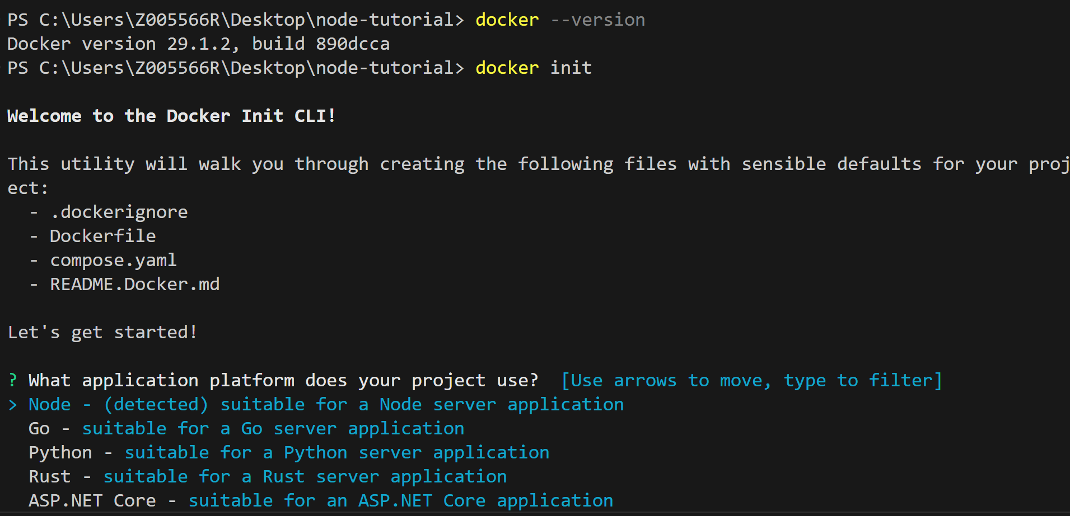
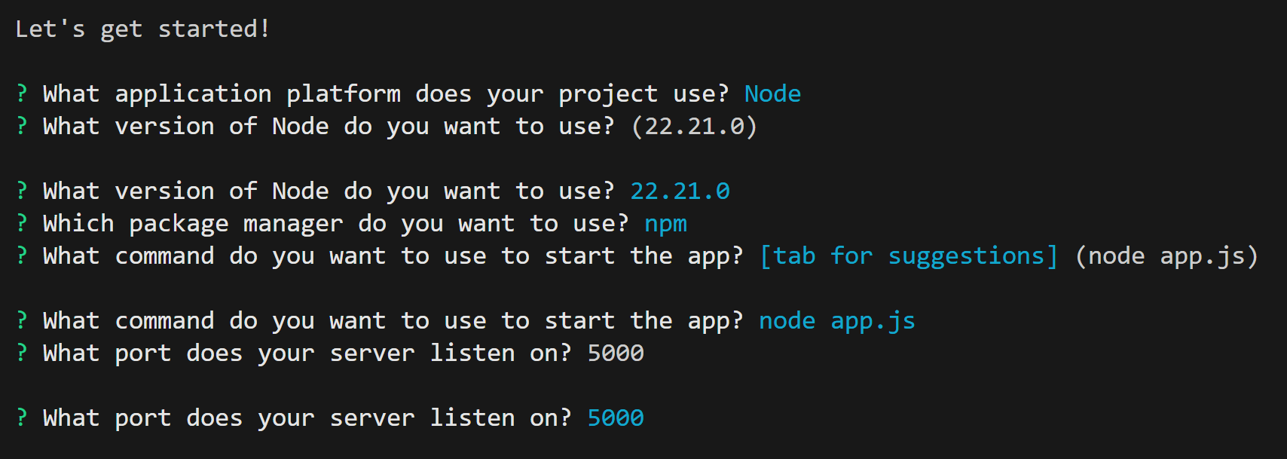
Step 2: Initialize Docker Project
We will first use docker –version in vscode terminal to ensure docker is installed successfully
We will then initialize docker project using the docker init
You will find some questions to answer related to your app

Slide 28

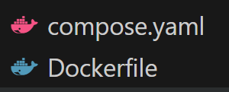

Step 2: Initialize Docker Project
When you run docker init, Docker generates several files to help you containerize your application.You will find the following files created after initialization:
.dockerignore -> A file that tells Docker which files/folders to exclude when building an image.
Dockerfile -> A text file with instructions to build a Docker image.
Compose.yaml -> A YAML file that defines and runs multi-container Docker applications.
README.Docker.md -> Documentation file with instructions on how to use the generated Docker files.

Slide 29
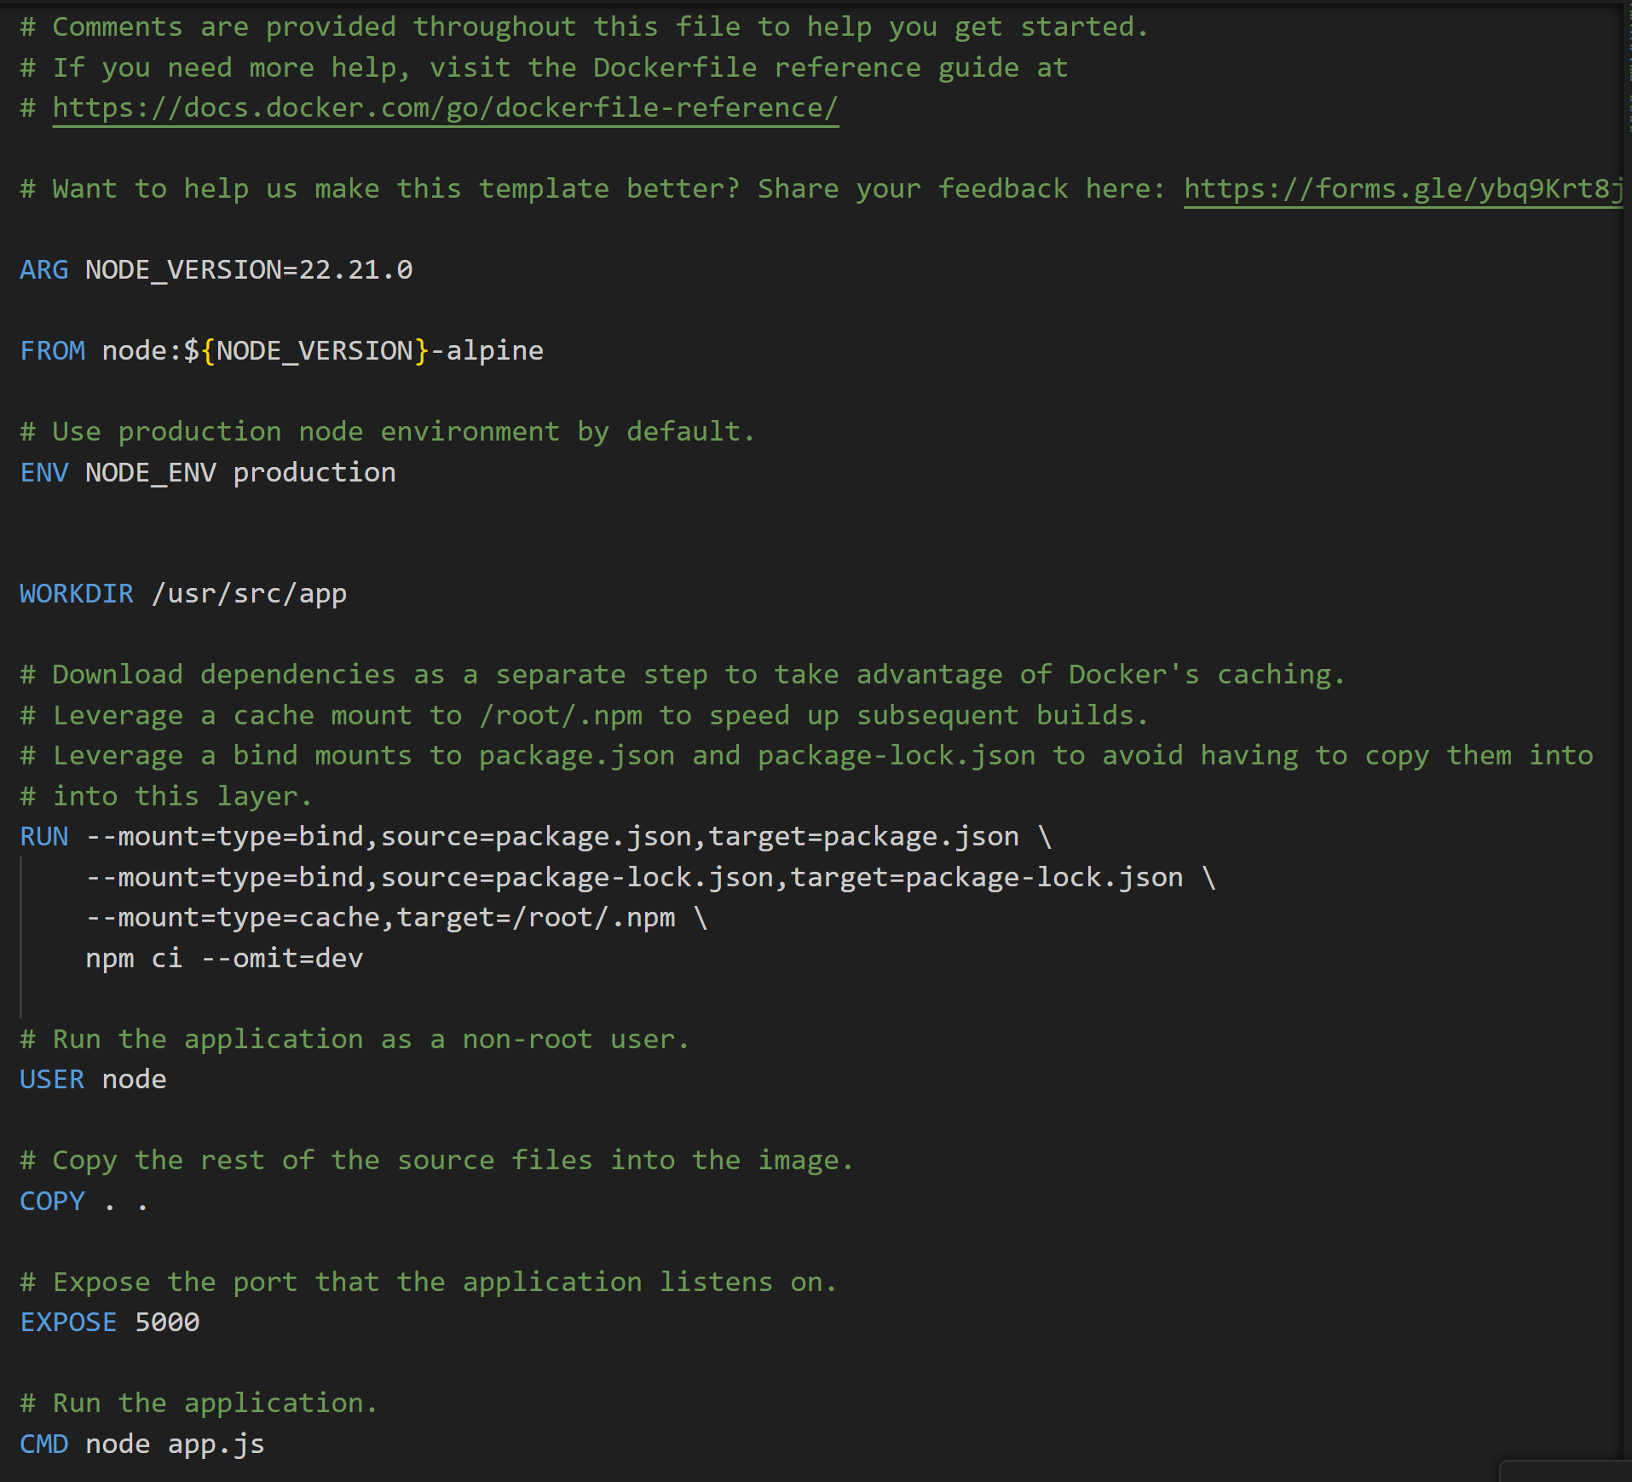
Step 3: Creating the DockerFile
In the dockerfile we need to write instructions that defines how to package your application
Specifies dependencies and runtime
Creates reproducible builds
You will see that the docker init command already wrote the instructions we gave it when answering the environment questions

Slide 30
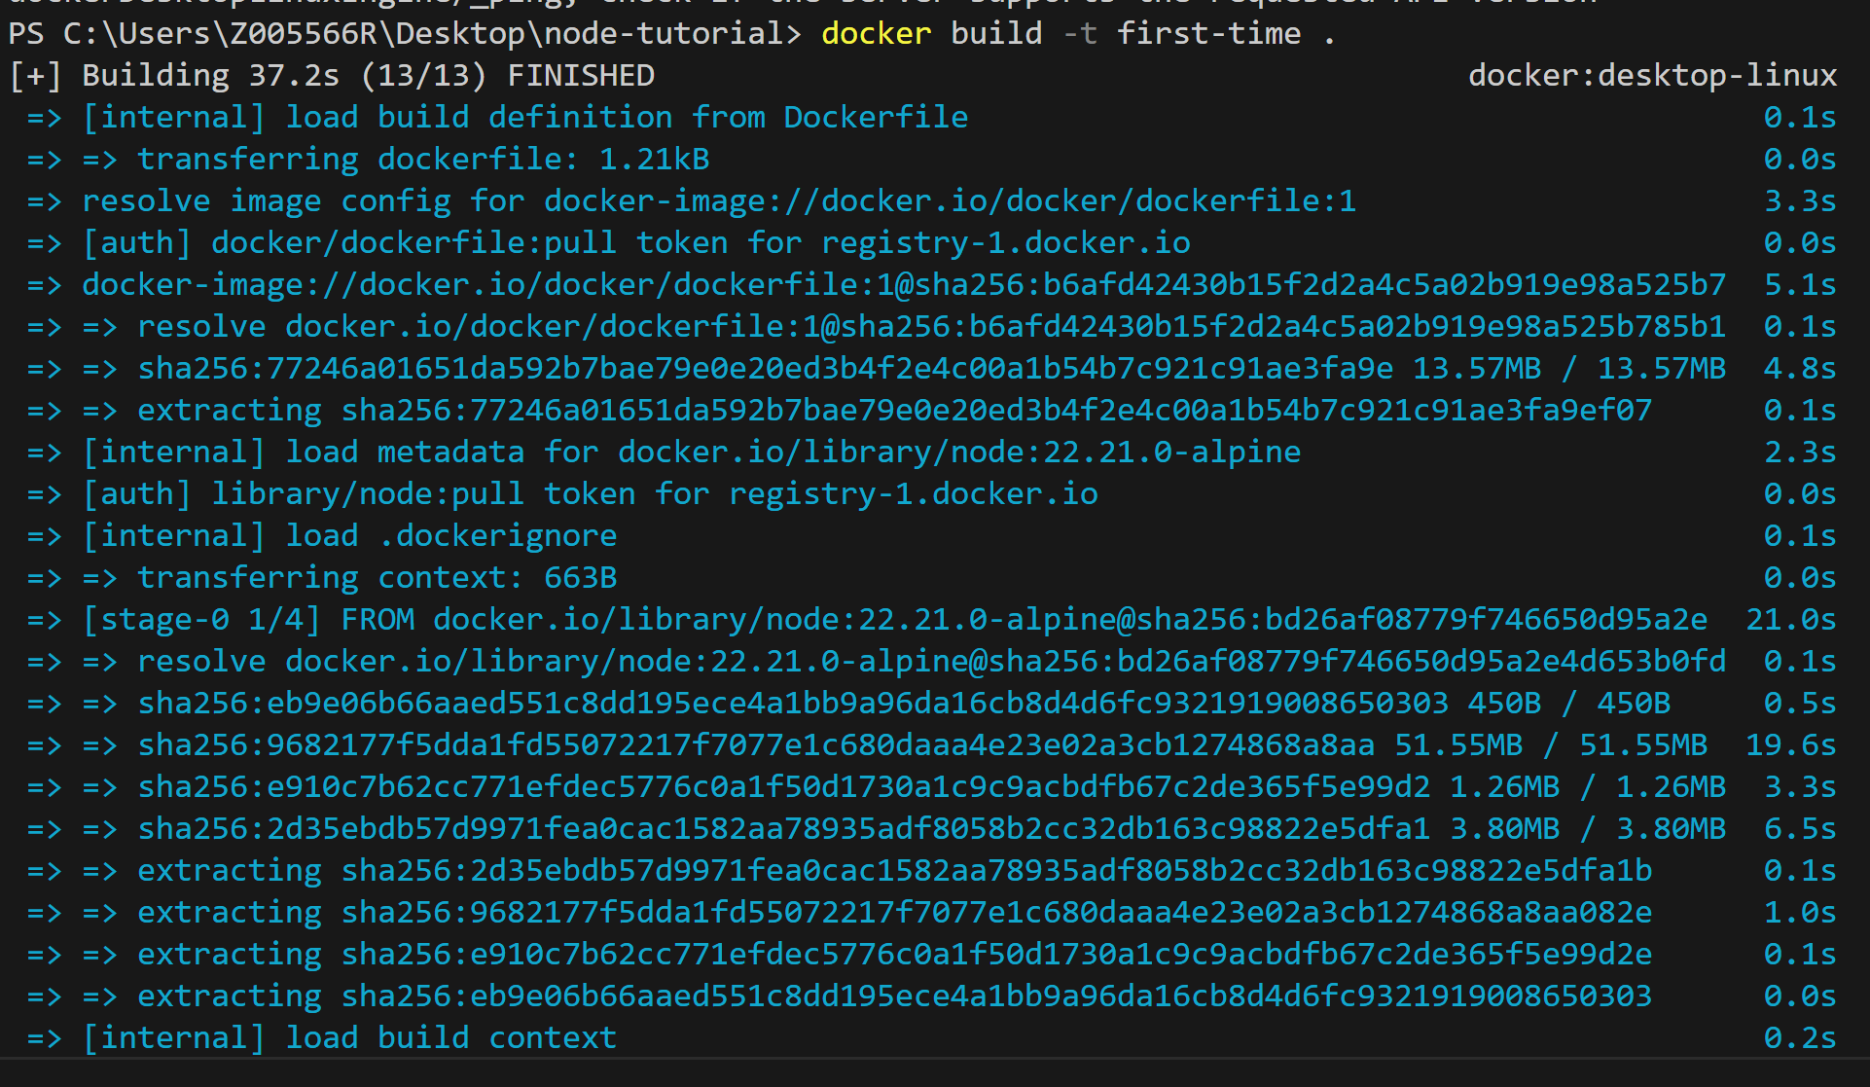
Step 4: Building the docker image
Before running our docker image in a container, we first need to build it.
Make sure your docker desktop engine is running first
For this we will use the docker build command with the -t flag to provide a name for the image
Docker image is a snapshot of your code at the time you built it. If you change your code, the old image still contains the old code.
This steps in each line in our docker file to download dependencies.

Slide 31
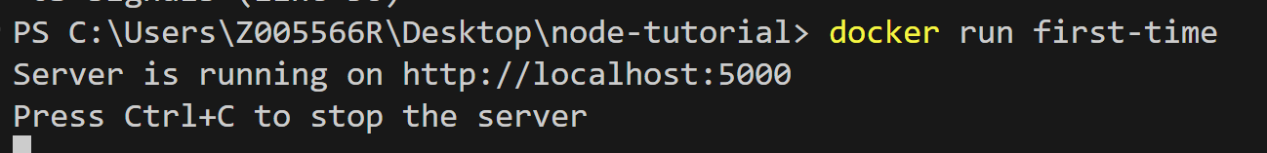
Step 4: Running your docker image in a container
To startup a container with your docker image we will use the docker run command
Your server is now running and you can access it through the web browser

Slide 32
Github Actions

Slide 33
CI/CD
Before getting into Github Actions, let’s dive into the CI/CD concept.
CI/CD (Continuous Integration/Continuous Delivery) is the practice of automating the manual tasks that we usually have to do when we are deploying our code to production
Things like:
Compiling our code
Running tests
Uploading code to cloud infrastructure
Automating things not only helps us to save time but it also removes the possibility of human error causing production to be down.

Slide 34
Continuous Integration
Continuous Integration is the practice of automatically building and testing code whenever developers commit changes to a shared repository. A CI server fetches the latest code, compiles it, runs tests, and reports results. If the build or tests fail, developers receive a notification and fix the issues. When the pipeline succeeds, an artifact is produced and stored for deployment to testing or production environments. CI is typically followed by Continuous Delivery or Continuous Deployment, which automate the release process further.
When the developer commits any code, an automated process fetches the code, build it and test it and sends a notification if there is any failure.
This automated process is called continuous integration which includes: Code -> Fetch -> Build -> Test -> Notify -> Feedback -> Code
The goal of CI is to detect defects in an early stage so it doesn’t multiply
One tool for CI includes Jenkins

Slide 35
Continuous Delivery
Continuous Delivery is the practice of automatically deploying every code change that passes automated tests and quality checks directly to production, without human intervention.
The goal is to shorten the release cycle so users get new features, fixes, and improvements as soon as they’re ready and verified.

Slide 36
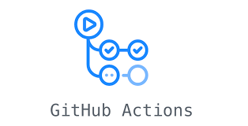
Github Actions Intro
GitHub Actions IS a CI/CD tool!
It's the engine that powers your CI/CD pipeline.
GitHub Actions is GitHub's built-in automation platform that allows you to automate your software development workflows directly within your GitHub repository.
Think of GitHub Actions as a robot assistant that automatically does tasks for you whenever something happens in your code repository.
Instead of manually doing repetitive tasks, GitHub Actions does them for you automatically.
For example:
Someone pushes code → Robot runs tests automatically
Someone opens a pull request → Robot checks code quality
You create a release → Robot deploys to production

